Slide 1

Project On
Student Management System
Submitted By:-
UID:- 23BCA10449(Ritesh Prasad Sah)
UID:- 23BCA10662(Mumtaj Ali)
UID:- 23BCA10751(Shaurya Singh)
Sec:- 23BCA7 “B”
Submitted To:- Ms. Anika Garg
(E12764)

Slide 2






Student Management System in C++
A student management system is a software application designed to streamline various administrative tasks associated with managing student data. It enables efficient tracking of student information, academic records, attendance, and other relevant details.

Slide 3
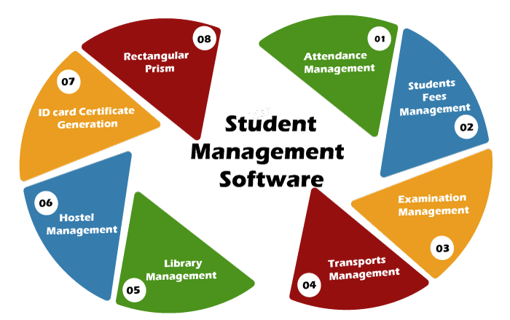
Core Modules
Student Module
Admin Module
Handles student registration, enrollment, and profile management.
Manages Student Details. Student Registration, Delete records, modify,etc
Attendance Module
Student Login Module
Tracks student attendance records and generates reports.
Facilitates exam scheduling, grading, and result analysis.

Slide 4
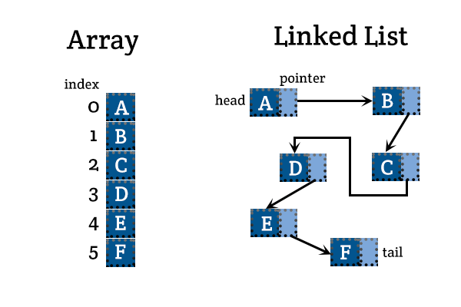
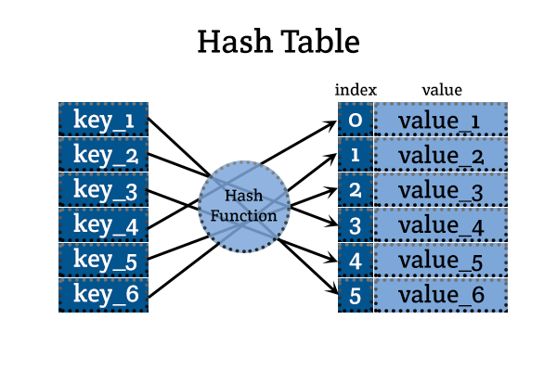
Data Structures and Algorithms
1
Arrays
Used to store student records, course details, and other lists of data.
2
Linked Lists
Provide flexibility for dynamic data management, such as student enrollment and course registration.
3
Hash Tables
Enable efficient retrieval of student or course data based on unique identifiers.
4
Trees
Used for organizing and searching hierarchical data, such as course hierarchies or student enrollment records.

Slide 5
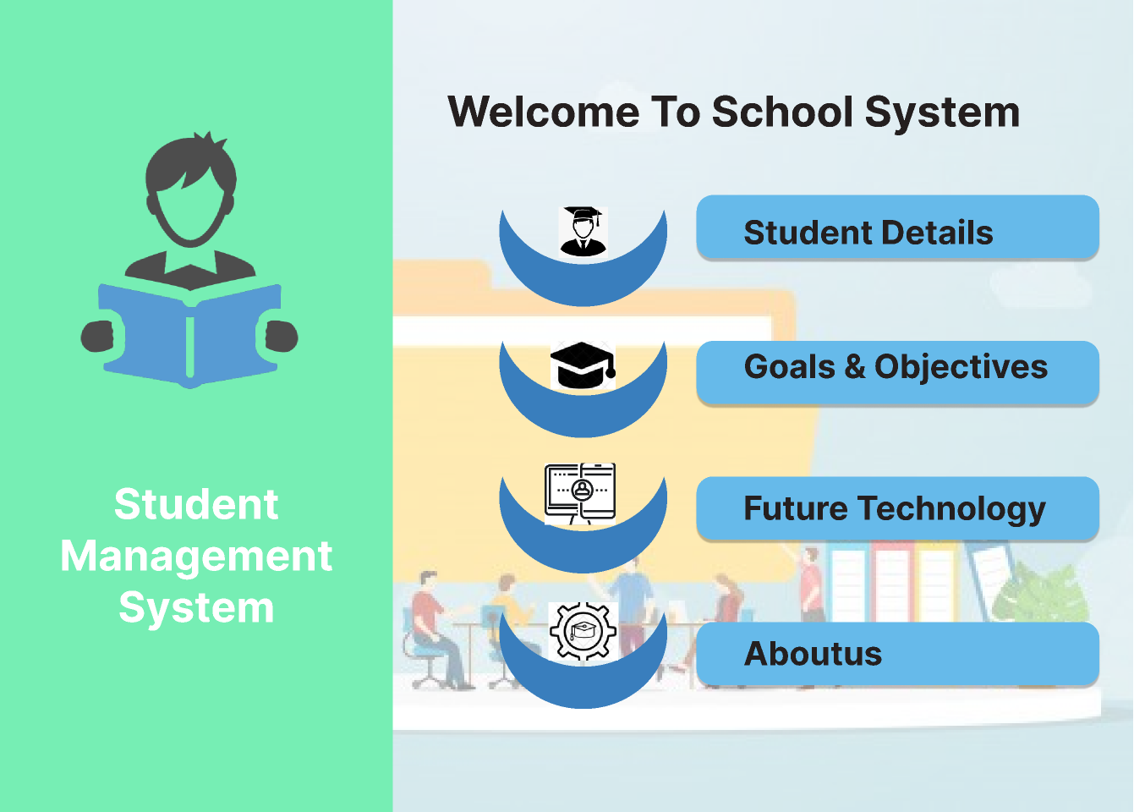
Implementation and Deployment
1
Design
Planning the system architecture and defining core modules.
2
Coding
Implementing the system using C++ programming language.
3
Testing
Verifying system functionality and ensuring accuracy.
4
Deployment
Installing and configuring the system on the target environment.

Slide 6
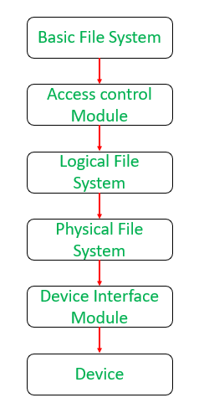
Project Setup and Structure
File Organization
The project will be structured with multiple files, separating different functionalities for better organization and maintainability.
Classes
We will define classes to encapsulate data and functionalities related to students, administrators, attendance, and other features.
Headers
Header files will contain function declarations and class definitions, promoting code reusability and modularity.

Slide 7
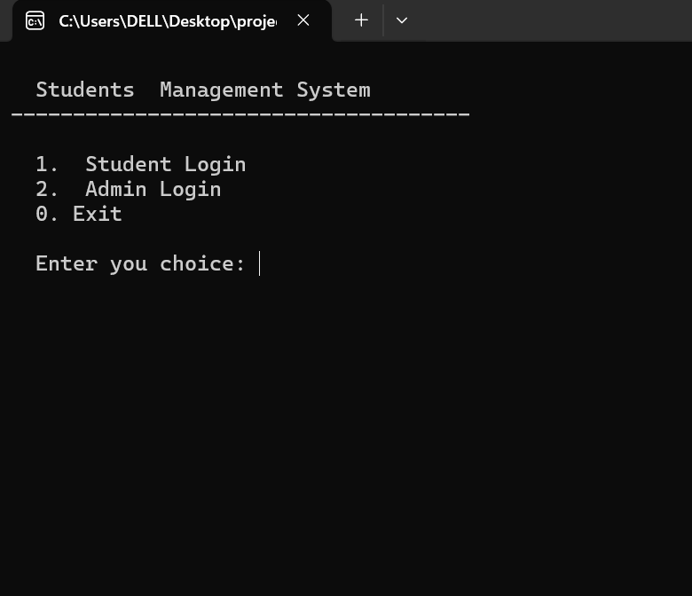
Main Screen
Navigation
The Main Screen provides a clear and intuitive navigation system for students and administrators.
User Access
It allows users to easily access either the Admin Login or Student Login screens.
System Information
It displays general information about the system, such as its version and purpose.

Slide 8
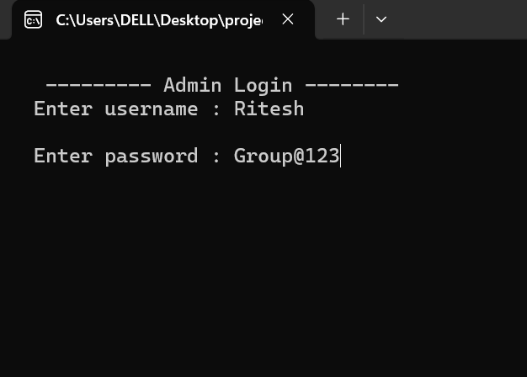
Admin Login Screen
Username
Password
The username field requires the admin's unique identifier, ensuring authorized access.
The password field protects sensitive data with a strong password input field.
Login
Once the username and password are entered, then press Enter to login initiates authentication.

Slide 9
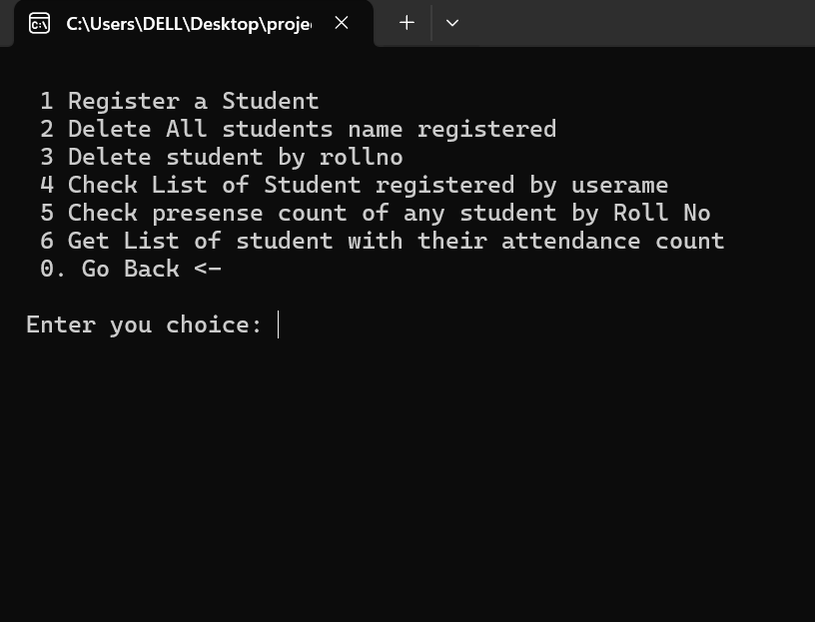
Admin View Screen
1
Student List
Provides a comprehensive list of all registered students, displaying key information such as name, ID, and registration date.
2
Data Management
Offers tools for updating student information, adding new students, and deleting existing records.
3
System Logs
Displays a detailed log of all system activities, including student registration, login attempts, and data modifications.
4
Reports
Generates customizable reports on student performance, enrollment trends, and other relevant data.

Slide 10
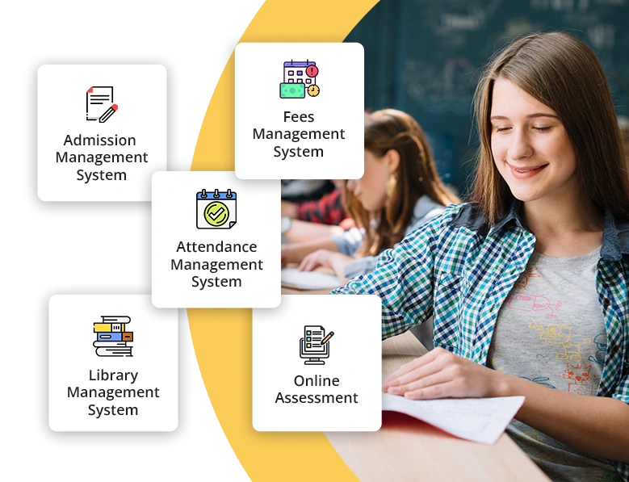
Admin View Functionality
1
Student Management
Allow administrators to add, delete, and modify student records.
2
Attendance Tracking
Provide tools to record attendance, generate reports, and analyze attendance patterns.
3
System Configuration
Enable administrators to customize system settings and preferences.
4
User Permissions
Implement role-based access control to restrict specific functionalities to administrators.

Slide 11
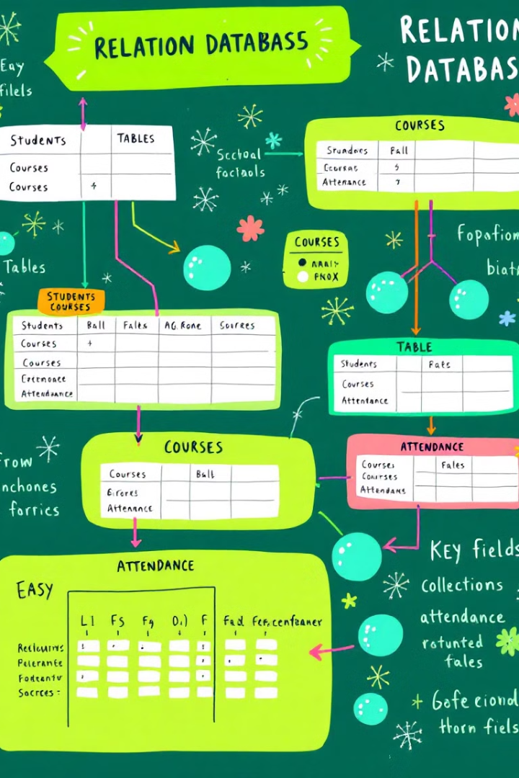
Student Database Management
Function
Description
Add Student
Create a new entry in the database for a student, storing details like name, roll number, and contact information.
Update Student
Modify existing student data, allowing administrators to update personal details, course enrollment, and other information.
Delete Student
Remove a student record from the database, ensuring data integrity and consistency.

Slide 12

Delete All Student Screen
Confirm Deletion
A prompt appears, asking the admin to confirm the deletion of all student data.
Data Removal
If confirmed, the system securely removes all student records from the database.
Confirmation
A notification appears, informing the admin of the successful deletion of all student data.

Slide 13
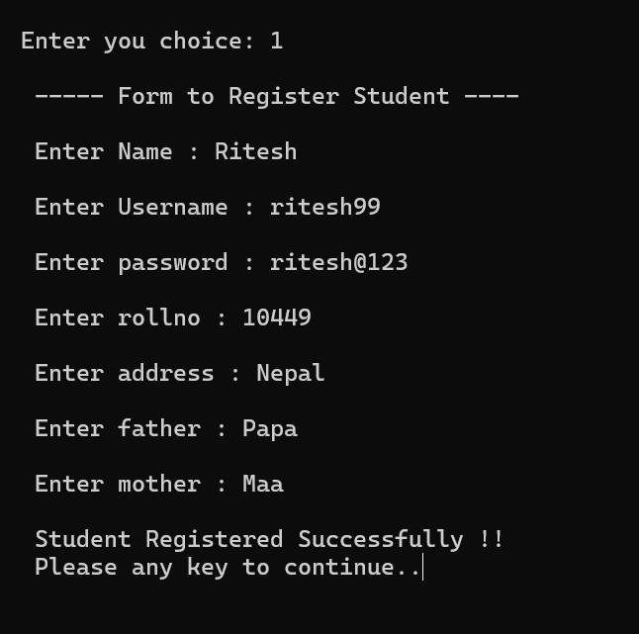
Student Registration Screen
1
Fill Form
Students fill out the registration form with their personal details and choose a secure password.
2
Submit Form
After reviewing the submitted information, students submit the form to complete the registration process.
3
Confirmation
The system validates the submitted data and displays a confirmation message upon successful registration.

Slide 14
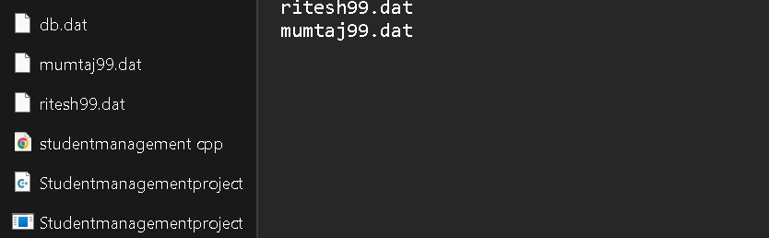




Registered Student Screen
Student Profile
Edit Profile
System Settings
Exit
Displays the registered student's profile, including their unique ID, name, email, and registration date.
Allows students to update their personal information, such as name, email, and password.
Enables students to manage their account settings, such as privacy preferences and notification settings.
Provides an option for students to securely logout from the system and end their session.

Slide 15
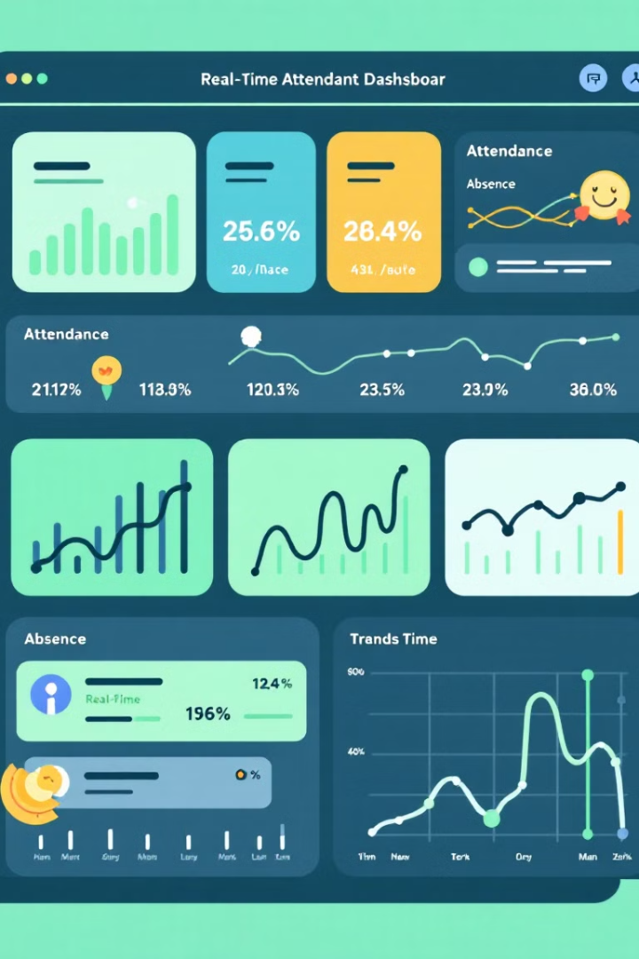



Attendance Tracking and Reporting
Date and Time
The system will record the date and time of each attendance entry.
Presence Status
Each student will be marked as present or absent for each attendance record.
Reports and Analytics
Generate attendance reports, analyze attendance patterns, and identify potential trends.

Slide 16
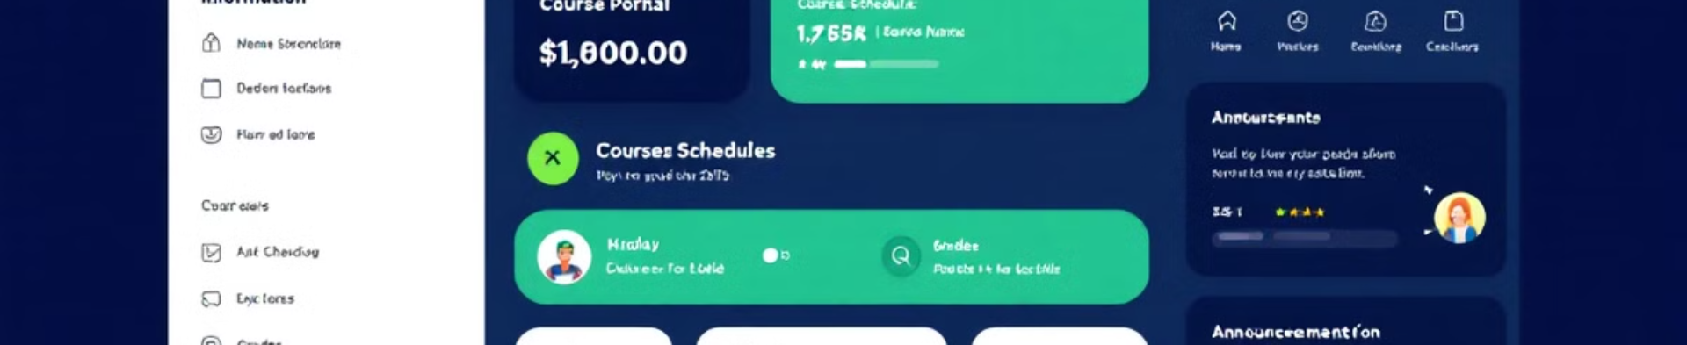
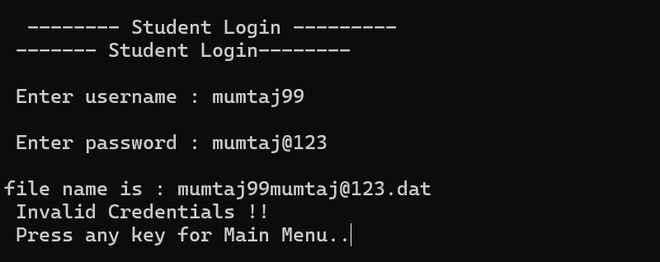
Student View Functionality
View Profile
Check Attendance
Access Course Materials
Allow students to access and update their personal information, including name, contact details, and academic records.
Enable students to view their attendance records and track their attendance history.
Provide a platform for students to access course syllabi, lecture notes, and assignments.

Slide 17
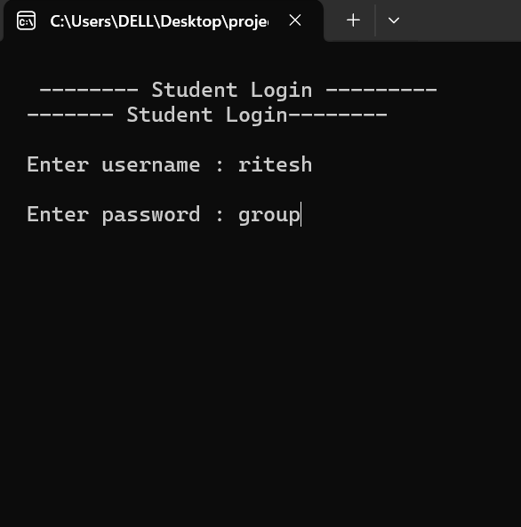



Student Login and Credential Verification
Username and Password
Students will use their unique usernames and passwords to access the system.
Database Lookup
The system will verify entered credentials against the student database.
Access Granted
Upon successful verification, the system will grant access to the corresponding student view.

Slide 18

Thank You

